Slide 1
DELOITTE’S VIRTUAL INTERNSHIP
PRESENTATION ON-
“CLOUD COMPUTING”
Submitted By:
Krithika Jagannath

Slide 2
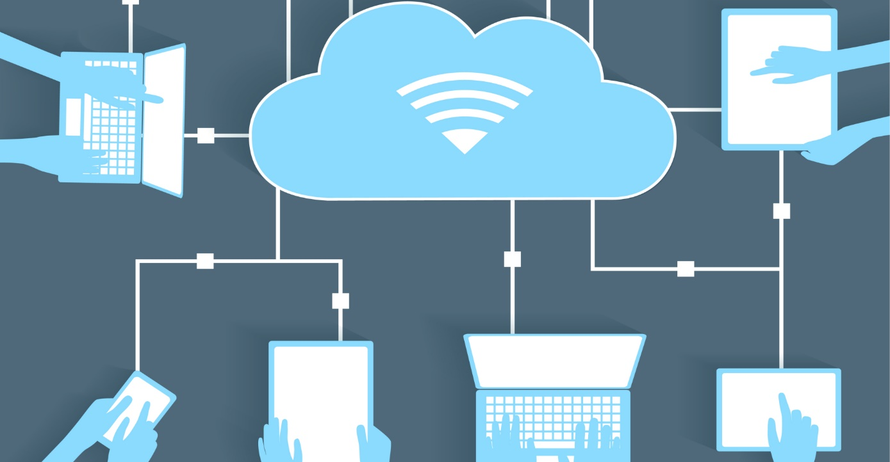
CONTENTS:-
What is Cloud?
Cloud Characteristics
Cloud capabilities

Slide 3
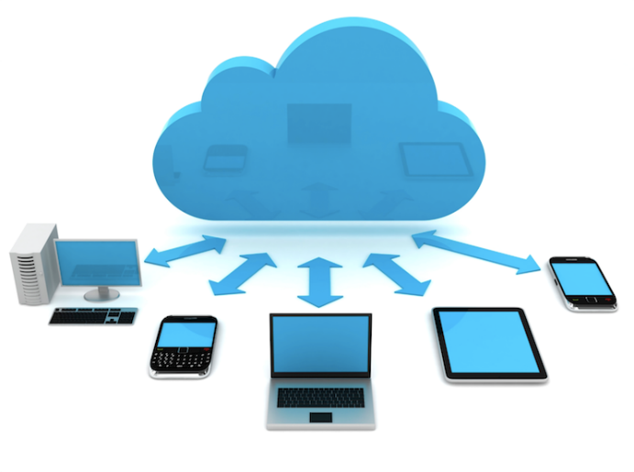
WHAT IS CLOUD?
"The cloud" refers to servers that are accessed over the Internet, and the software and databases that run on those servers. Cloud servers are located in data centers all over the world. By using cloud computing, users and companies don't have to manage physical servers themselves or run software applications on their own machines. In simple terms cloud computing means storing and accessing data and programs over the Internet instead of your computer's hard drive.

Slide 4
Cloud Characteristics
On-demand self-services: The Cloud computing services does not require any human administrators, user themselves are able to provision, monitor and manage computing resources as needed.
Broad network access: The Computing services are generally provided over standard networks and heterogeneous devices.
Rapid elasticity: The Computing services should have IT resources that are able to scale out and in quickly and on as needed basis. Whenever the user require services it is provided to him and it is scale out as soon as its requirement gets over.
Resource pooling: The IT resource (e.g., networks, servers, storage, applications, and services) present are shared across multiple applications and occupant in an uncommitted manner. Multiple clients are provided service from a same physical resource.
Measured service: The resource utilization is tracked for each application and occupant, it will provide both the user and the resource provider with an account of what has been used. This is done for various reasons like monitoring billing and effective use of resource.

Slide 5
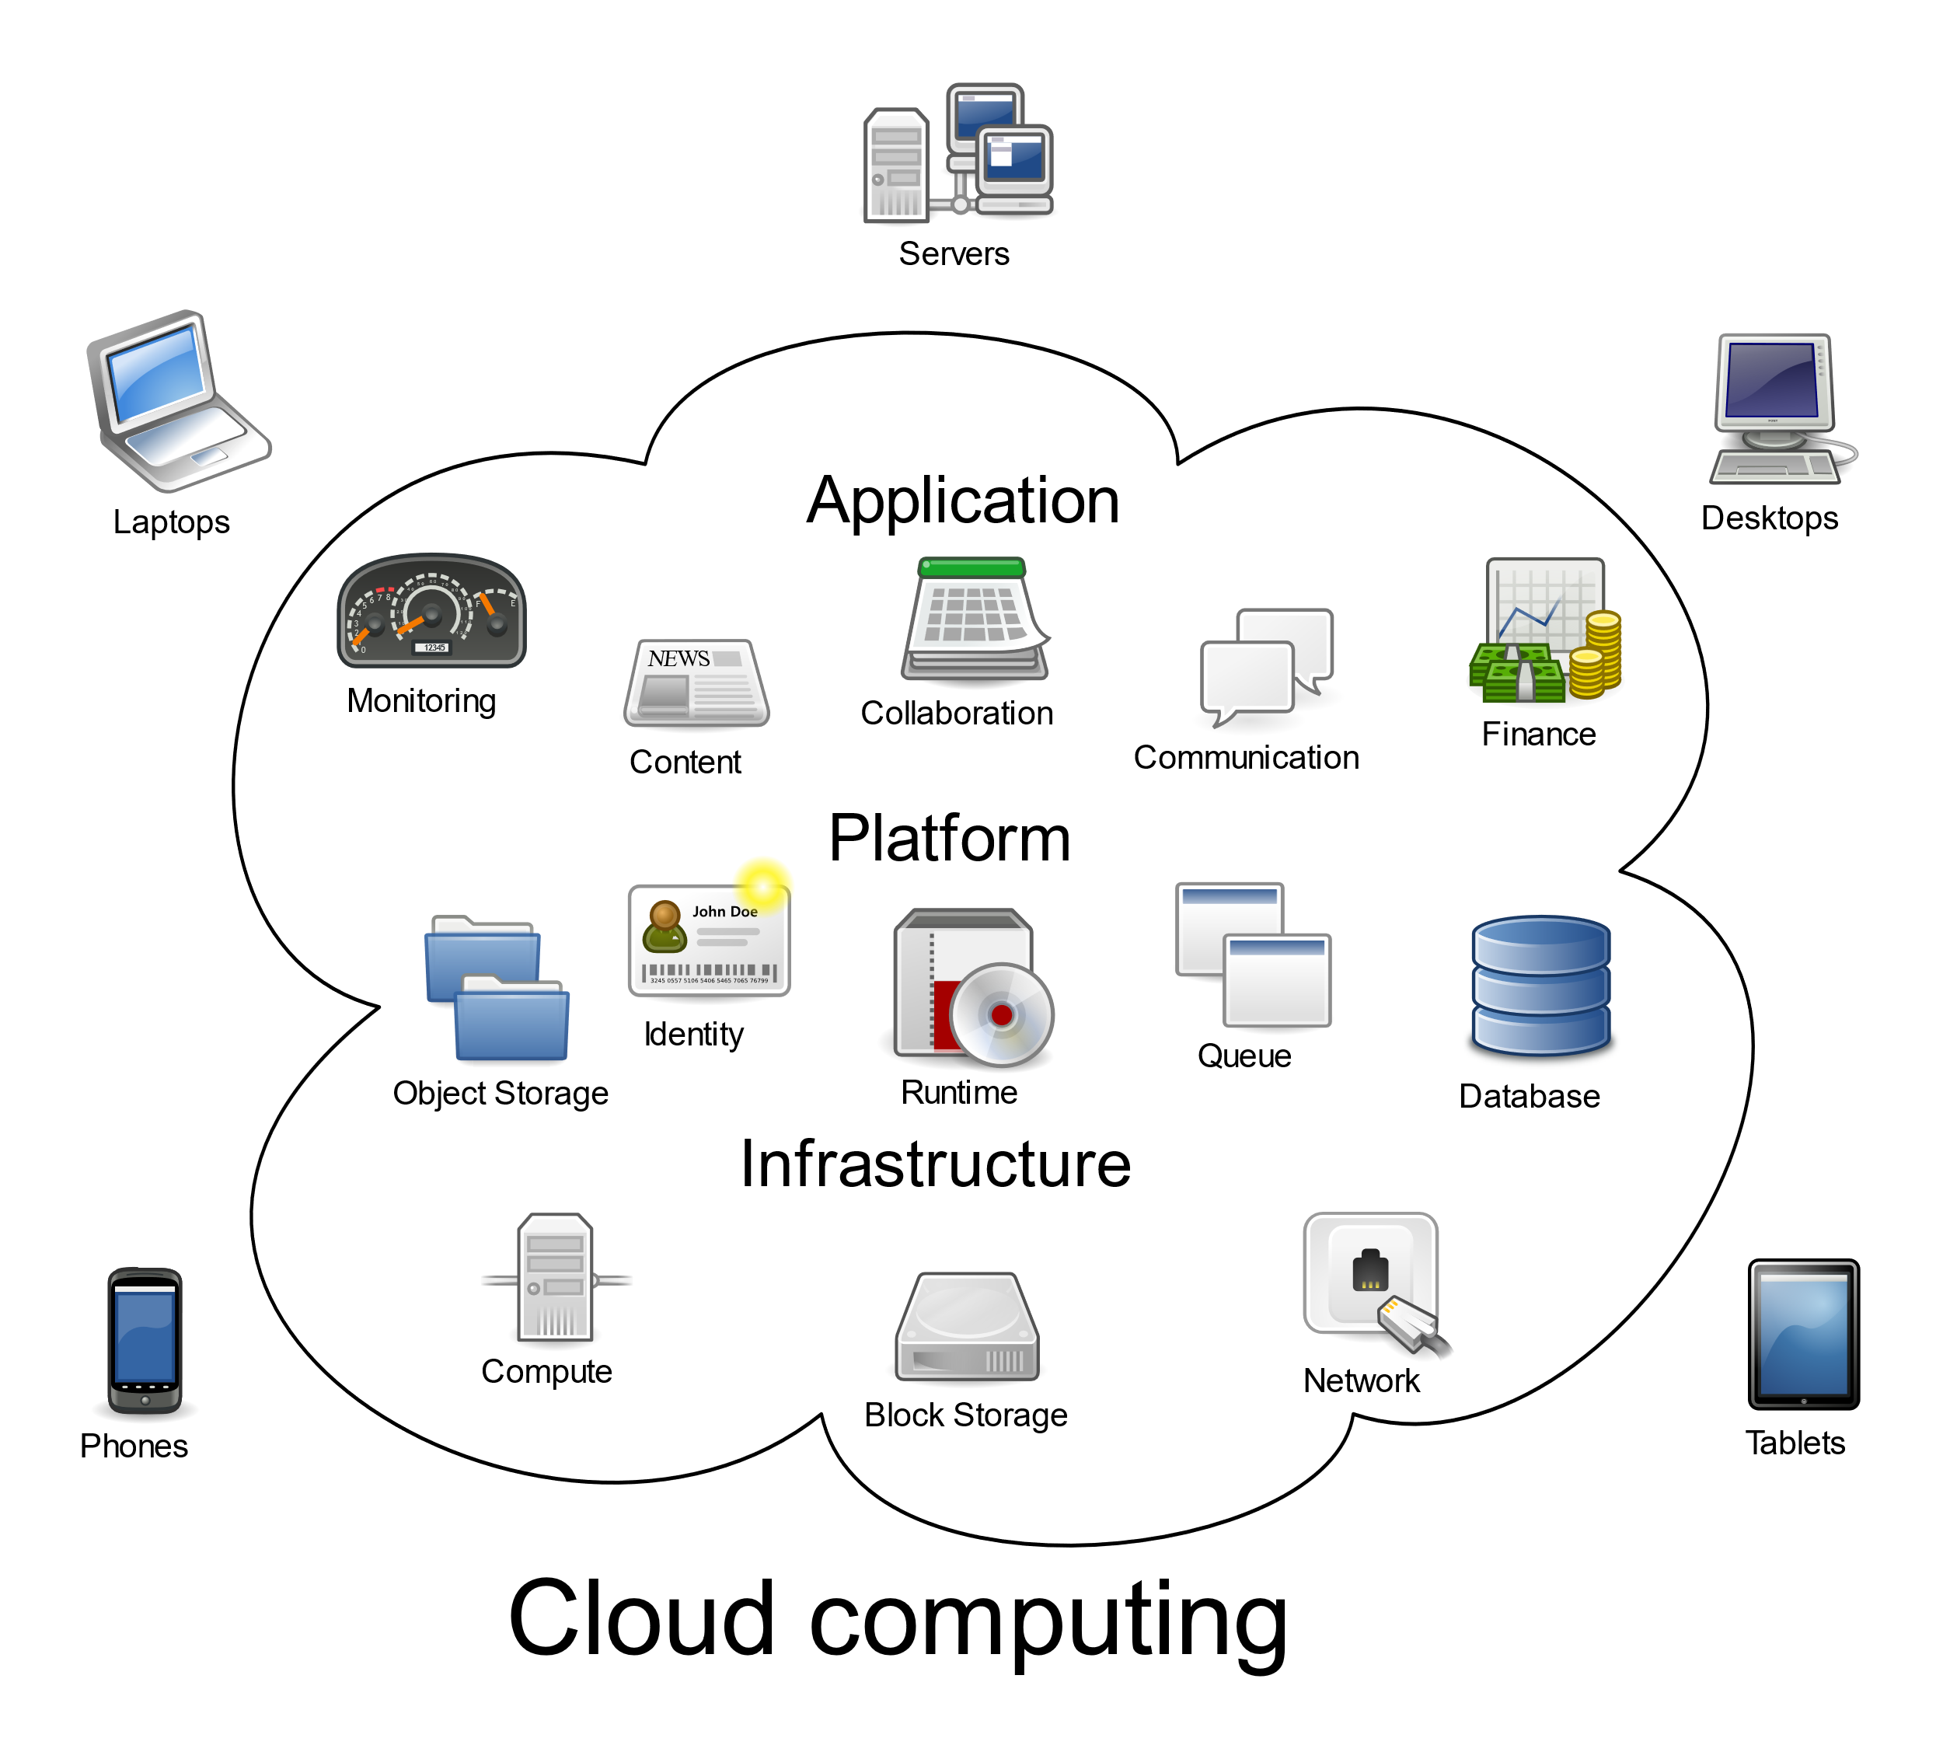
Cloud capabilities
Controlled Interface
Location Independence
Sourcing Independence
Ubiquitous Access
Virtual Business Environments
Addressability and Traceability
Rapid Elasticity

